Slide 1
INTRODUCTION TO MACHINE LEARNING
INTRODUCTION
Andreu Arderiu
NORTHIN SUMMER SCHOOL
Barcelona, July 2022

Slide 2
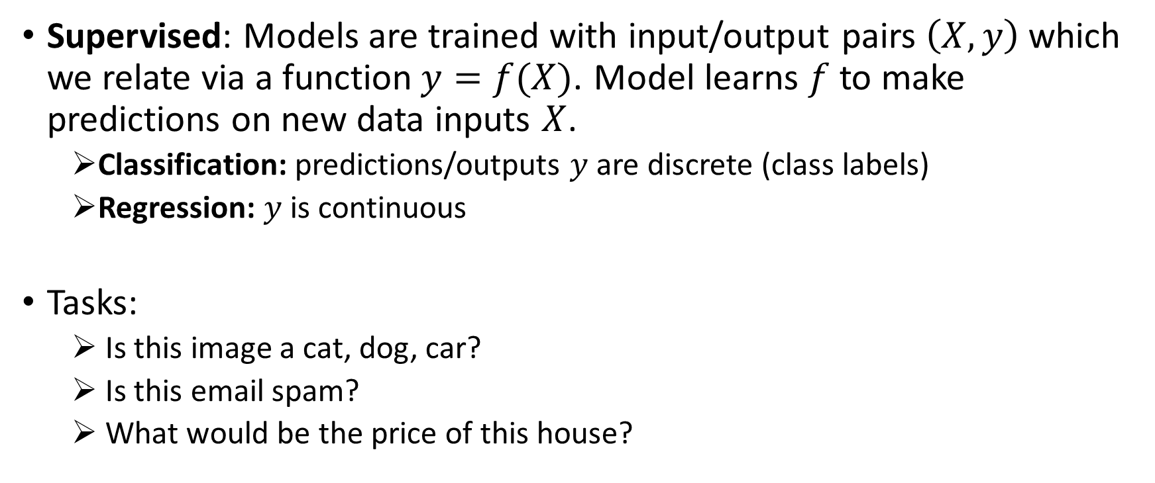
Supervised learning: overview
Supervised: Models are trained with input/output pairs $\left(X,y\right)$which we relate via a function$y=f(X)$. Model learns $f$to make predictions on new data inputs $X$.
Classification: predictions/outputs $y$ are discrete (class labels)
Regression: $y$ is continuous
Tasks:
Is this image a cat, dog, car?
Is this email spam?
What would be the price of this house?

Slide 3
Supervised learning: algorithms
k-NN (k nearest neighbours)
Naive Bayes
Linear + logistic regression
Support vector machines
Random forests
Supervised neural networks
etc…
Today!

Slide 4
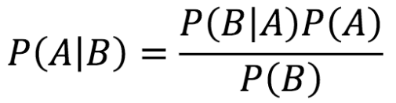
Bayes rule overview
P(A|B): “Posterior”, probability that A happens given that the evidence B already happened
P(B|A): “Likelihood”, probability that B happens given that A already happened
P(A): “Prior”, probability that A will happen
P(B): probability that B happens

Slide 5

Bayes rule quizz
We are planning a picnic but the morning is cloudy. What is the chance of afternoon rain?
From historical weather data we know that:
P(Clouds|Rain) = 0.5: 50% of the rainy days were cloudy in the morning
P(Rain) = 0.1 : 10% of the days it rained in the afternoon
P(Clouds) = 0.4: 40% of the days are cloudy
$$P\left(Rain | Clouds\right)=$$

Slide 6
Bayes rule quizz
We are planning a picnic but the morning is cloudy. What is the chance of afternoon rain?
From historical weather data we know that:
P(Clouds|Rain) = 0.5: 50% of the rainy days were cloudy in the morning
P(Rain) = 0.1 : 10% of the days it rained in the afternoon
P(Clouds) = 0.4: 40% of the days are cloudy
$$P\left(Rain | Clouds\right)=\frac{0.1×0.5}{0.4}=0.125$$
12.5% chance of rain!

Slide 7
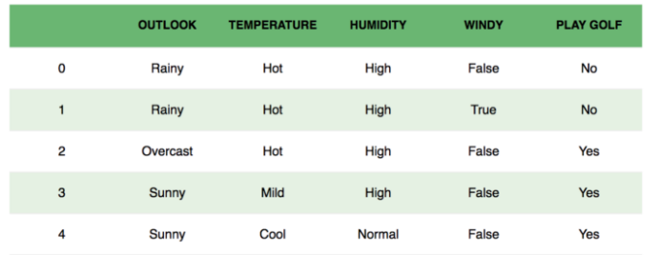
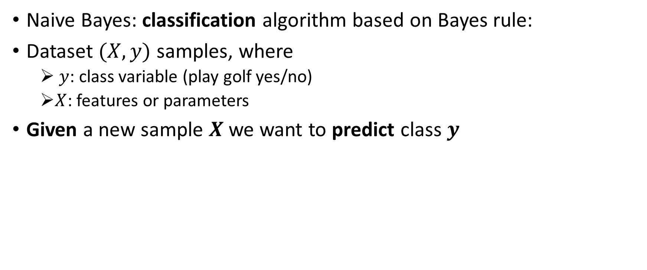
Naive Bayes: Golf example
Naive Bayes: classification algorithm based on Bayes rule:
Dataset $(X,y)$ samples, where
$y$: class variable (play golf yes/no)
$X$: features or parameters
Given a new sample $X$ we want to predict class $y$

Slide 8
Naive Bayes: Golf example
$X=(x_{1},$ $x_{2},$ $x_{3},$ $x_{4})$, where $x_{1}$= outlook, $x_{2}$= temperature, …
$P\left(y | x_{1}, x_{2}, x_{3}, x_{4}\right)=\frac{P\left(x_{1} | y\right)P\left(x_{2} | y\right)P\left(x_{3} | y\right)P\left(x_{4} | y\right)P(y)}{P(x_{1})P(x_{2})P(x_{3})P(x_{4})}$
$y=argmax_{y}P(y)\sum_{i=1}^{4}{\frac{P\left(x_{1} | y\right)}{P(x_{1})}}$
We asume $x_{1},$ $x_{2},$ $x_{3},$ $x_{4}$ are independent.
e.g. Temperature does not afect humidity
“Naive”

Slide 9


Naive Bayes: Pros and cons
Pros
Easy to use and computationally cheap
If assumption of independent features holds, performs well with few data
Cons
Features are rarely independent
Zero-frequency: If test set has a categorical variable or category not observed in the training test, the Naive Bayes model Will always (erronously) assign a 0 probability

Slide 10
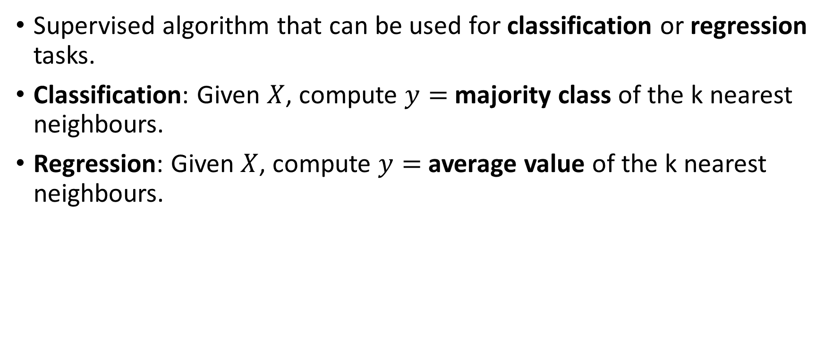
K-nearest neighbours (k-nn)
Supervised algorithm that can be used for classification or regression tasks.
Classification: Given $X$, compute $y=$ majority class of the k nearest neighbours.
Regression: Given $X$, compute $y=$average value of the k nearest neighbours.

Slide 11
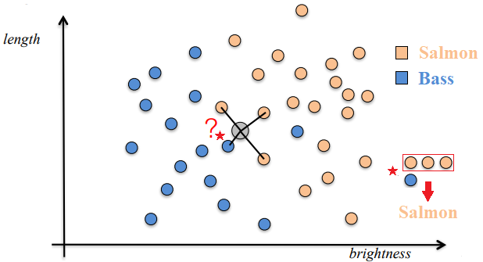
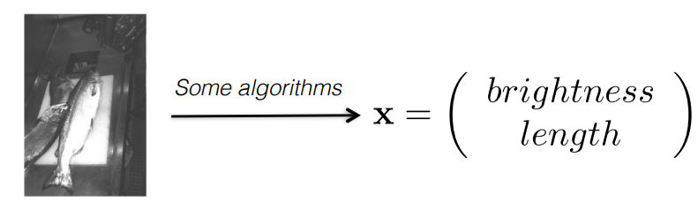
K-nearest neighbours: classification
Given a new $x$, find its k nearest neighbours according to some distance measure
Classify the point according to the majority of labels of its nearest neighbours
K = 4
Is it a bass or a salmon?
Credit: Bob West, EPFL

Slide 12
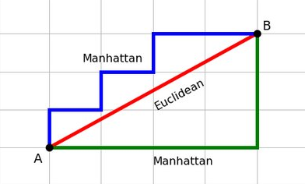
k-NN similarity/distance measures
Euclidean distance: Simplest, fast to compute
$$d\left(x,y\right)=\left\|x−y\right\|$$
Cosine distance: Good for documents, images
$$d\left(x,y\right)=1−\frac{x·y}{\left\|x\right\|\left\|y\right\|}$$
Manhattan distance: Coordinate-wise distance
$d\left(x,y\right)=\sum_{i=1}^{n}{|x_{i}−y_{i}|}$
…
Source: Omni calculator

Slide 13
Quizz: k-NN, choosing k
We have a bias/variance tradeoff
When k increases how does bias and variance change?
Small k
Large k

Slide 14
Quizz: k-NN, choosing k
We have a bias/variance tradeoff
When k increases how does bias and variance change?
Small k low bias, high variance
Large k high bias, low variance

Slide 15
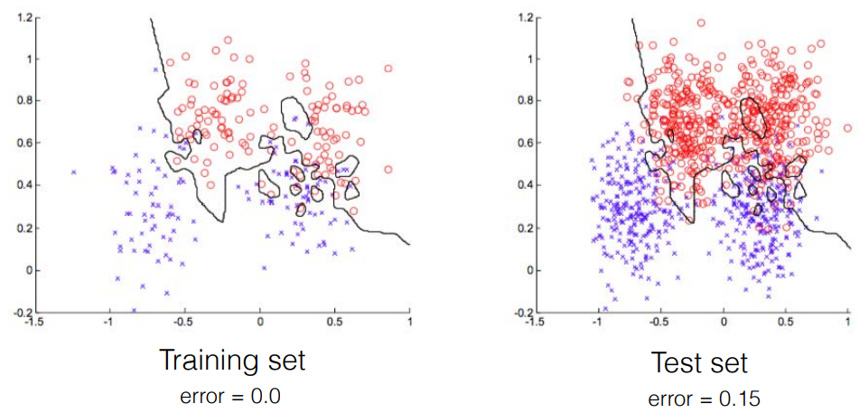
k-NN: choosing k, bias-variance tradeoff
Classification error with k=1 (low bias,high variance)
Credit: Bob West, EPFL

Slide 16
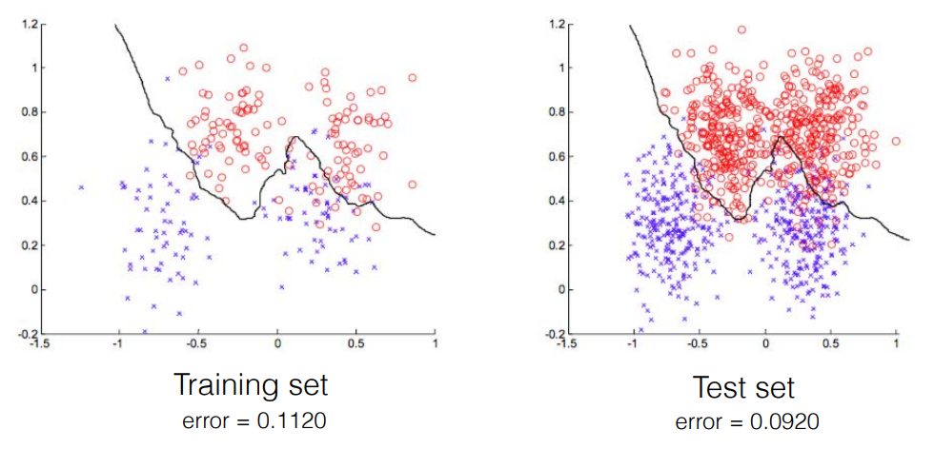
K-NN: choosing k, bias-variance tradeoff
Classification error with optimal k=21.
Credit: Bob West, EPFL

Slide 17
K-NN: pros and cons
Pros:
Intuitive and simple
Used for classification (binary and multi-class) and regression
Just one hyperparameter k, no need to train a model, the data is the model!
Cons:
Slow: as dataset size grows, computational cost grows very fast
Curse of dimensionality: as number of variables grows, performance declines
Sensitive to outliers

Slide 18
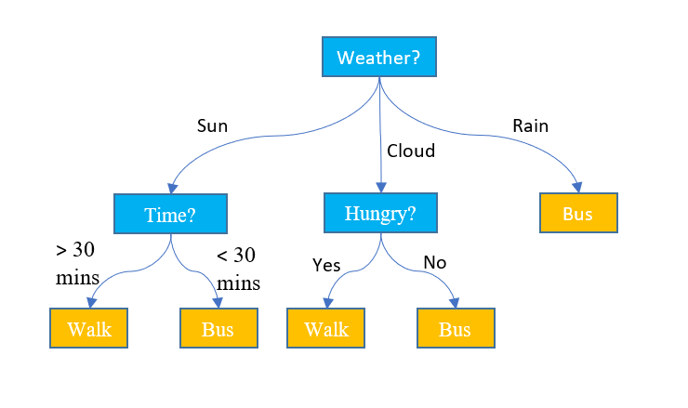
Decision trees: overview
Supervised algorithm that can be used for classification or regression tasks.
The model follows a flow-chart tree structure
Nodes are tests on a single attribute
Branches are attribute values
Leaves are class labels (classification) or output values (regression)
Source: SQLshack

Slide 19
Decision tree induction
Examples are partitioned recursively based on “most discriminative” features
Partitioning stops if
All simples belong to the same class (classification)
Number of simples in the partition is below a given threshold
There are no attributes left for splitting (categorical attributes)
Maximum depth is reached
Leaf predictions
Class majority vote (classifications)
Local average (regression)

Slide 20
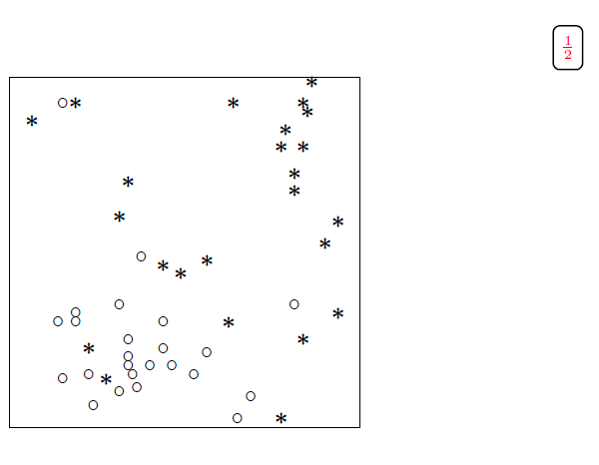
Decision tree: example
25
25
N=50
Credit: Guillaume Dehaene, EPFL

Slide 21
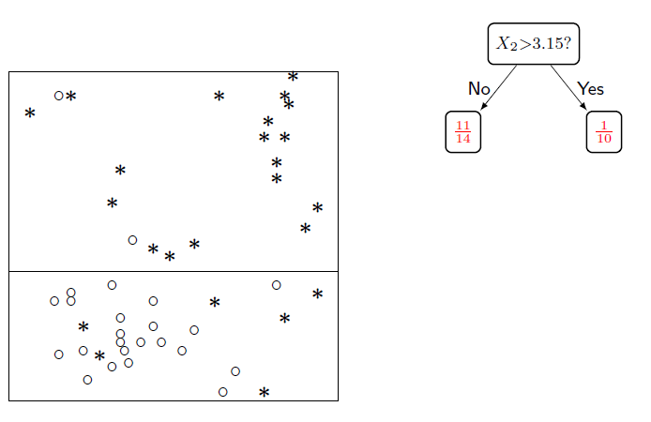
Decision tree: example
Credit: Guillaume Dehaene, EPFL

Slide 22
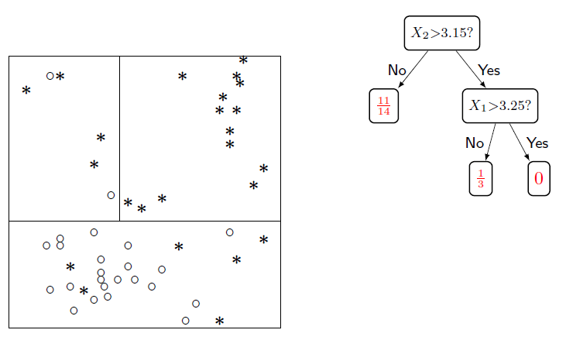
Decision tree: example
Credit: Guillaume Dehaene, EPFL

Slide 23
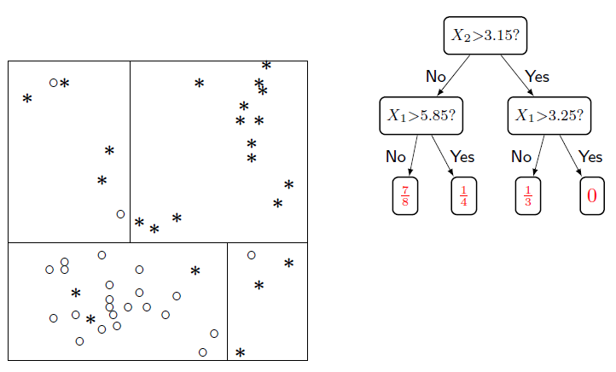
Decision tree: example
Credit: Guillaume Dehaene, EPFL

Slide 24
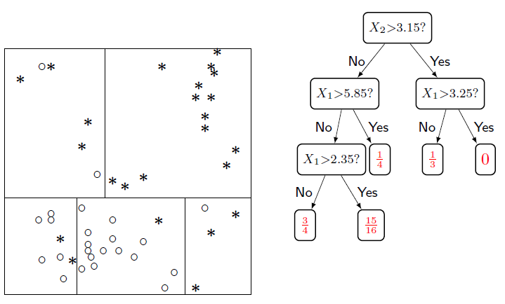
Decision tree: example
Credit: Guillaume Dehaene, EPFL

Slide 25
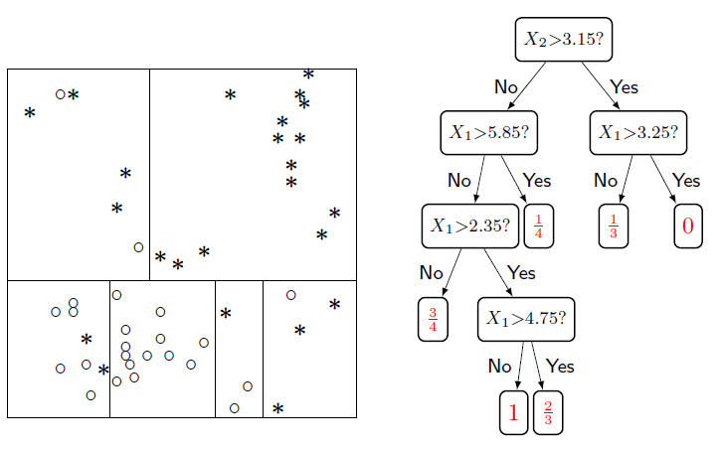
Decision tree: example
Credit: Guillaume Dehaene, EPFL

Slide 26
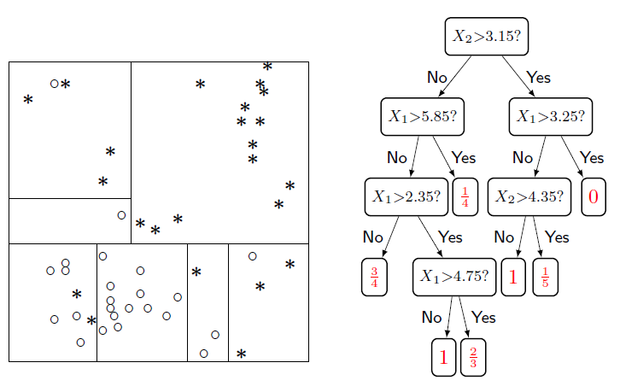
Decision tree: example
Credit: Guillaume Dehaene, EPFL

Slide 27
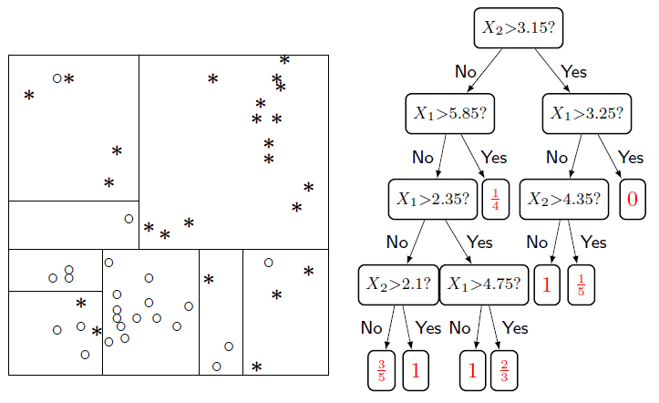
Decision tree: example
Credit: Guillaume Dehaene, EPFL

Slide 28
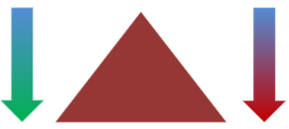
Quizz: bias-variance
As tree Depth increases, how do bias and variance change?

Slide 29
Quizz: bias-variance
As tree Depth increases, how do bias and variance change?
Bias decreases with tree depth
Variance increases with tree depth

Slide 30
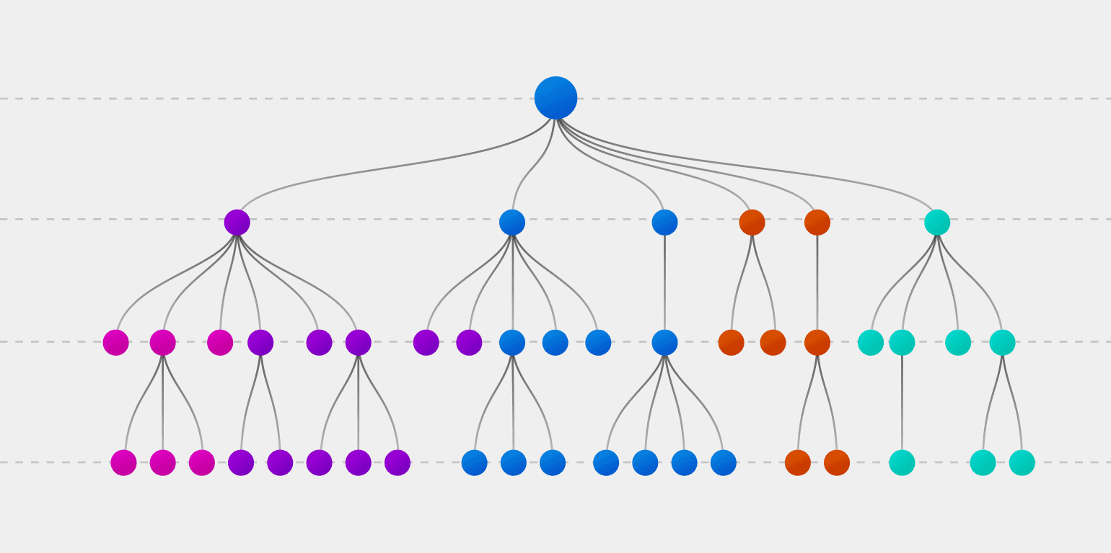
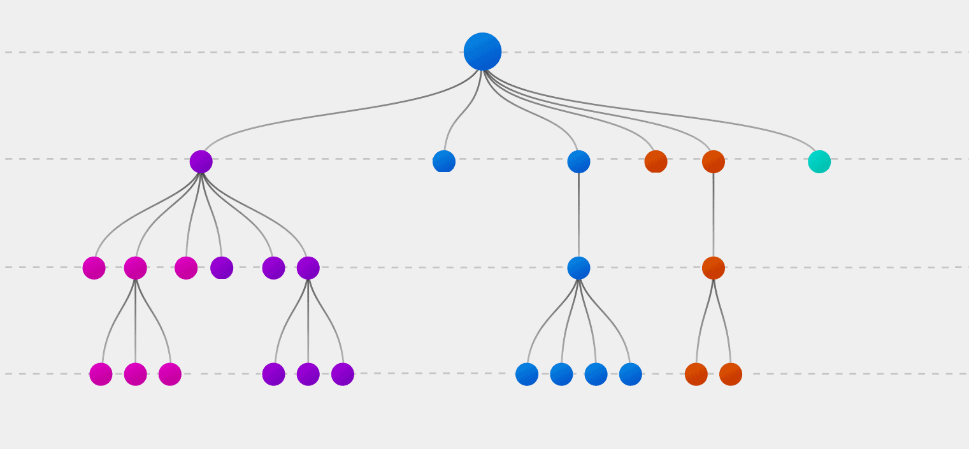
Decision trees: pruning
Reduce the complexity of the tree by removing branches, reduce overfitting!
Replace nodes with leaves and keep the change if accuracy in validation set does not decrease
Pruning

Slide 31
Decision trees: pros and cons
Pros
Easy to explain and human-interpretable
Handles both classification and regression
Fast and makes no asssumptions about the shape of the data
Cons
Splits have high variance, they tend to overfit!
Poor performance

Slide 32
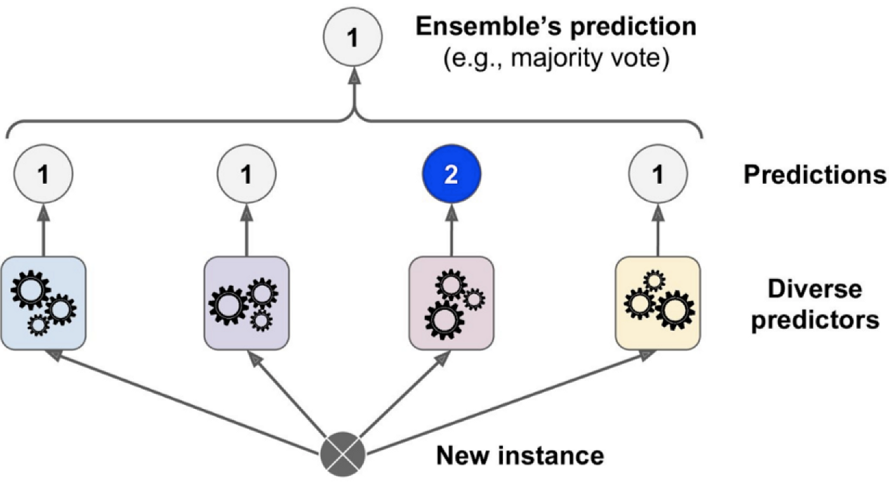
Ensemble methods
Combine results of weak learners to make a single better learner
Popular methods:
Random forests
Boosted trees
Source: “Hands-On Machine Learning with Scikit-Learn, Keras & TensorFlow”, Chapter 7.

Slide 33
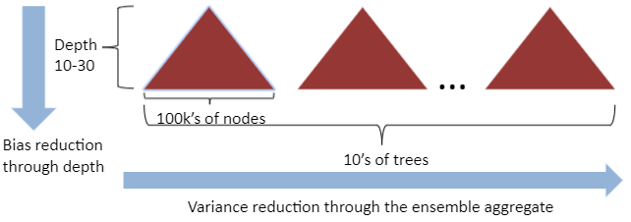
Random forests
Grow K trees on datasets sampled from the original dataset (size N, p features) with replacement (Bootstrap simples)
Drak K Bootstrap simples of size N
Grow each decisión tree by selecting a random subset m of features at each node, and choosing the best feature to split on
Aggregate predictions of the trees (average, most popular vote,…)
Credit: Robert West, EPFL

